Slide 1

FreeSpirit – A Celebration Of Sharing Happiness

Slide 2








Meeting Agenda – 28/29 November 2020
MVP Definition
Broadcast Feature Decision
Bank Partnership Status & Options
Pricing Model Review
VC Decision
Roles & Responsibilities (RACI)
Next Steps

Slide 3
Typical Merchant Configuration
Customer Segment | Scale | Reference Values | Notes
Average Customer Base | Based on Selection Criteria | 8000 | Conservative Approach
Loyal (Regular) Customers | 15% | 1200 | Based on median customer retention trend
WAIŪ Members (From Loyal Base) | 25% | 300 | Primary prospects, due to higher average ticket size
WAIŪ Members (From Remaining Customers) | 10% | 700
Total WAIŪ Members |  | 1000 | This does not include direct WAIŪ Customers
Bank Partner Customers | 4% | 40,000 | Based on Cosmos Bank Pune

Slide 4

Pricing Model - F&B Purchase
Model for Individual Merchant’s Monthly Business
Pricing Segment | Scale | Reference Values | Notes
Target Customer Base | All WAIŪ Members | 1000 | Conservative Approach
Average Ticket Size |  | ₹ 2,000 | F&B Bill Per Table
Monthly Business Volume |  | ₹ 20,00,000
Merchant Share | 82% | ₹ 16,40,000 | Balanced against current & general market trend
Customer Cashback | 10% | ₹ 2,00,000 | As a trigger for next purchase on WAIŪ
WAIŪ Commission | 8% | ₹ 1,60,000

Slide 5
Pricing Model - F&B Purchase (Partner Bank Customers)
Model for Individual Merchant’s Monthly Business
Pricing Segment | Scale | Reference Values | Notes
Target Customer Base | 4% Bank Customers | 3000 | Conservative Approach
Average Ticket Size |  | ₹ 2,000 | F&B Bill Per Table
Monthly Business Volume |  | ₹ 60,00,000
Merchant Share | 82% | ₹ 49,20,000 | Balanced against current & general market trend
Customer Cashback | 12% | ₹ 7,20,000 | As a trigger for next purchase on WAIŪ
WAIŪ Commission | 6% | ₹ 3,60,000

Slide 6

Pricing Model - Offer Module
Model for Individual Merchant’s Monthly Business
Pricing Segment | Scale | Reference Values | Notes
Target Customer Base | 5% of WAIŪ Members | 50 | Conservative Approach
Average Ticket Size |  | ₹ 500 | F&B Bill Per Offer
Monthly Business Volume |  | ₹ 25,000
Offering Merchant Share | 16.6% | ₹ 4,150 | Earning without product dispensation
Redeeming Merchant Share | 41% | ₹ 10,250 | As a trigger for next purchase on WAIŪ
Customer Cashback | 5% | ₹ 1,250 | As a trigger for next purchase via WAIŪ
WAIŪ Commission | 37.4% | ₹ 9,350

Slide 7

Pricing Model – Delivery At Home
Model for Individual Merchant’s Monthly Business
Pricing Segment | Scale | Reference Values | Notes
Target Customer Base | 10% WAIŪ Members | 100 | Conservative Approach
Average Ticket Size |  | ₹ 600 | F&B Bill Per Table
Monthly Business Volume |  | ₹ 60,000
Merchant Share | 88% | ₹ 52,800 | 10% additional value, as compared to current market offers
Customer Cashback | 6% | ₹ 3,600 | As a trigger for next purchase on WAIŪ
WAIŪ Commission | 6% | ₹ 3,600

Slide 8
Pricing Model – Eat Now, Pay Later (Partner Bank Customers)
Model for Individual Monthly Business in one City
Pricing Segment | Scale | Reference Values | Notes
Target Customer Base | 2.5% Bank Customers | 1000 | Conservative Approach
Average Ticket Size |  | ₹ 10000 | F&B Bill Per Table
Monthly Business Volume |  | ₹ 1,00,00,000
Merchant Share | 82% | ₹ 82,00,000
Bank Partner Share | 6% | ₹ 6,00,000 | For Bank’s effort on CM collection, fraud liability etc.
WAIŪ Commission | 12% | ₹ 12,00,000

Slide 9
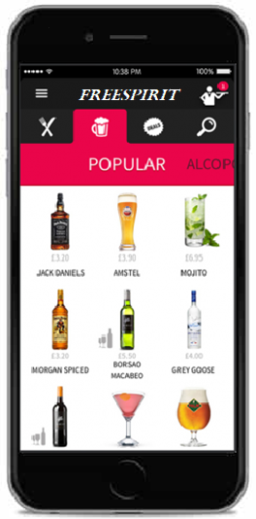





Product & Features - MVP
Gift a Friend
Gift or share a drink of choice to your beloved ones e.g. Corporates, Family & Friends & colleagues
Broadcast & Live Streaming
Watch live shows & virtually share special moments with the dear ones & staff training demonstrations
Offer a New Friend
Offer service will be availed at merchant establishment with other groups or individuals
Eat Now, Pay Later
Service for the our bank partner’s privileged customers
Purchase For Self
Instant cashback facility for regular customers to avail restaurant services
Events & Gaming
Promote corporate events, interactive games for in-house patrons
Payments & Point Wallet
Express true feeling of sharing & gifting with points instead of money
Food Delivery
Break the dependency of service aggregators, with reduced expenses

Slide 10
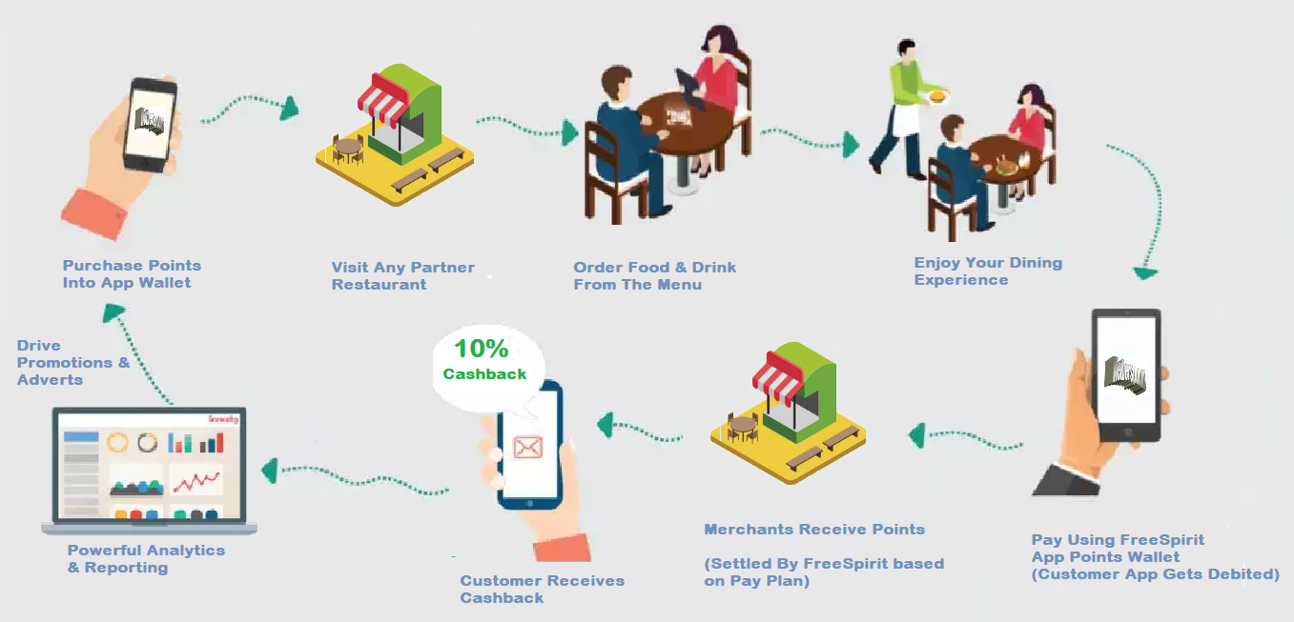
Indicative Process Flow – Purchase

Slide 11
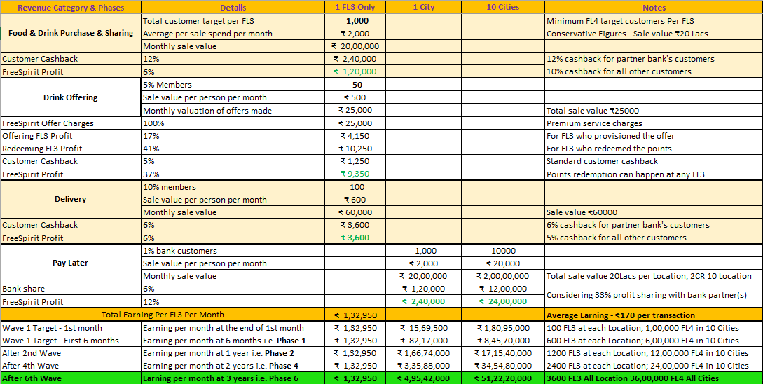
Revenue Model

Slide 12
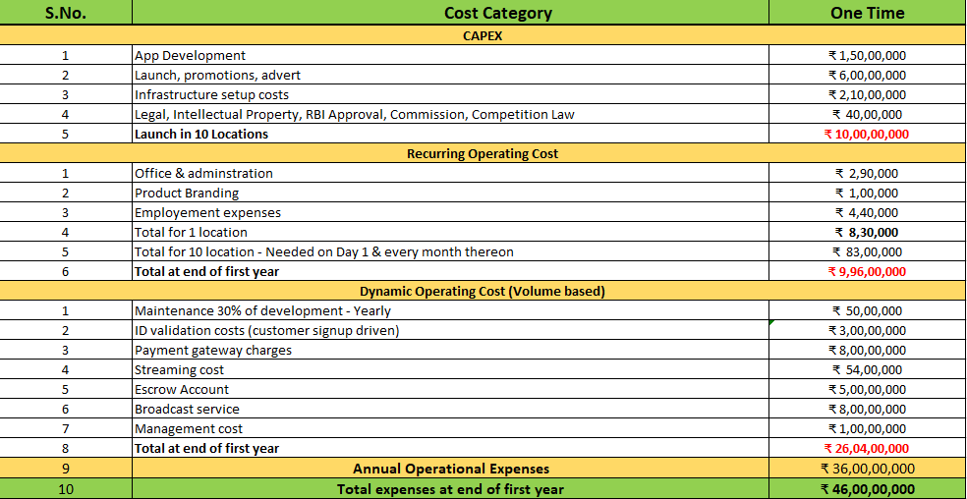
Capital Investment & Operational Expenditure

Slide 13






Question & Answers

